Slide 1
Research cluster : Machine Learning And
Data Analytics For The IOT
Team mentor: Mr.Md.Farhatullah
Team members: B.Uma Maheshwari-319136410012
B.Tejaswini-319136410013
D.charitha-319136410024
CH.Tejaswini-319136410028

Slide 2
STUDENT GRADE ANALYSIS & PREDICTION
USING MACHINE LEARNING

Slide 3
CONTENTS OF THIS TEMPLATE
❖Abstract ❖ALGORITHMS
❖Introduction ❖EXECUTION DEMO
❖MOTIVATION ❖TEST CASES
❖PROBLEM STATEMENT ❖CONCLUSION
❖REQUIREMENT ANALYSIS
❖UML DIAGRAMS

Slide 4
ABSTRACT
Predicting academic performance is an important task for the students in university, college, and school, etc. The factors which affect the student’s academic performance are class quizzes, assignments, lab exams, mid, and final exams. The student’s academic performance should be informed to the class teacher in advance that will decrease the student’s dropout and increase the performance. In this project, machine learning classification algorithms such as, logistic regression,linear regression and Random Forest regression are implemented to predict the student’s academic performance. The performance of an algorithm has been evaluated based on accuracy score.
⮚ In this project we take a dataset of students with some information about them, like gender, scores and other information.
⮚ And from that data, we will come to know what are their nxt scores using machine learning algorithms (linear regression,logistic regression).

Slide 5
INTRODUCTION
Modern learning institutions operate in a highly competitive and complex environment. Thus, analyzing performance, providing high-quality education, formulating strategies for evaluating the students’ performance, and identifying future needs are some challenges faced by most universities today. Student intervention plans are implemented in universities to overcome students’ problems during their studies. Student performance prediction at entry-level and during the subsequent periods helps the universities effectively develop and evolve the intervention plans, where both the management and educators are the beneficiaries of the students’ performance prediction plans.

Slide 6
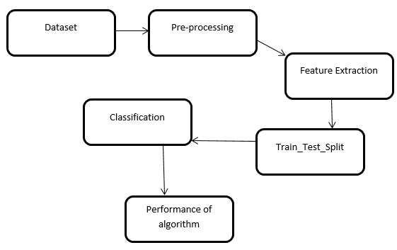
To implement this project first of all we need a data set.
To that data set we will apply data preprocessing.
Now we extract the required features.
We will divide the data into training testing and validation of the data.
Now we perform train function to train the machine.
The testing of network is been done by using predictor .
If there are no errors then our network can predict the final grades of the student .

Slide 7
Motivation
The main motive of this project is to predict the students performance in the final exams .
So that it helps the instructor to know about the students performance in before hand .
By this it helps the instructor to guide the students in the right way to achieve good grades.

Slide 8
Problem statement
In case of manual system they need lot of time to analyse the complete data set.
Here almost all work is computerized,so the accuracy is also maintained.

Slide 9
Requirement Analysis
Functional requirement
Non functional requirement
Grade prediction
Data sets
Software Requirements:- ▪Python 3.8
▪ Jupyter Notebook
Library Requirements:-
▪ Numpy
▪Pandas

Slide 10
UML DIAGRAMS

Slide 11
Class diagram
Class diagrams are the main building blocks of every object-oriented method. The class diagram can be used to show the classes, relationships, interface, association, and collaboration. UML is standardized in class diagrams. Since classes are the building block of an application that is based on OOPs, so as the class diagram has an appropriate structure to represent the classes, inheritance, relationships, and everything that OOPs have in their context

Slide 12
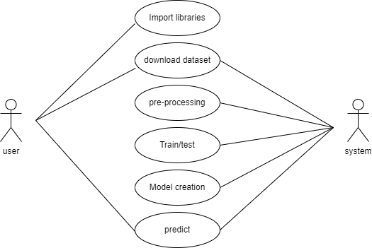
USE CASE DIAGRAM:
It shows the functionality of a system from the developers perspective.great way to communicate complex ideas.usually used to current system as well as proposed system

Slide 13
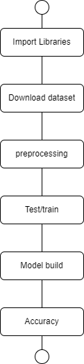
STATE CHART DIAGRAM:
State chart diagrams provide us an efficient way to model the interactions or communication that occur within the external entities and a system. These diagrams are used to model the event-based system. A state of an object is controlled with the help of an event. State chart diagrams are used to describe various states of an entity within the application system.

Slide 14
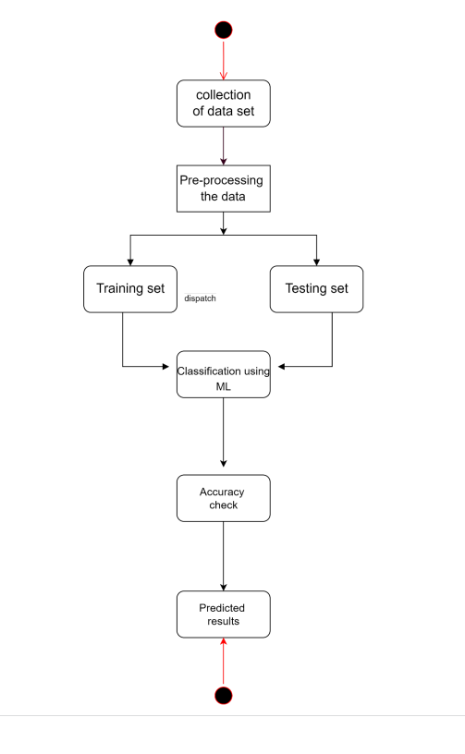
Activity diagram:
We use Activity Diagrams to illustrate the flow of control in a system and refer to the steps involved in the execution of a use case. We model sequential and concurrent activities using activity diagrams. So, we basically depict workflows visually using an activity diagram. An activity diagram focuses on condition of flow and the sequence in which it happens.

Slide 15
Algorithm:

Slide 16
Random forest regression:
Random forest is a supervised learning algorithm. The “forest” it builds is an ensemble of decision trees, usually trained with the “bagging” method. The general idea of the bagging method is that a combination of learning models increases the overall result.
random forest builds multiple decision trees and merges them together to get a more accurate and stable prediction.
One big advantage of random forest is that it can be used for both classification and regression problems, which form the majority of current machine learning systems.
Let’s look at random forest in classification, since classification is sometimes considered the building block of machine learning. Below you can see how a random forest would look like with two trees:
Random forest has nearly the same hyperparameters as a decision tree or a bagging classifier. Fortunately, there’s no need to combine a decision tree with a bagging classifier because you can easily use the classifier-class of random forest. With random forest, you can also deal with regression tasks by using the algorithm’s regressor.
Random forest adds additional randomness to the model, while growing the trees. Instead of searching for the most important feature while splitting a node, it searches for the best feature among a random subset of features. This results in a wide diversity that generally results in a better model.
Therefore, in random forest, only a random subset of the features is taken into consideration by the algorithm for splitting a node. You can even make trees more random by additionally using random thresholds for each feature rather than searching for the best possible thresholds (like a normal decision tree does).

Slide 17
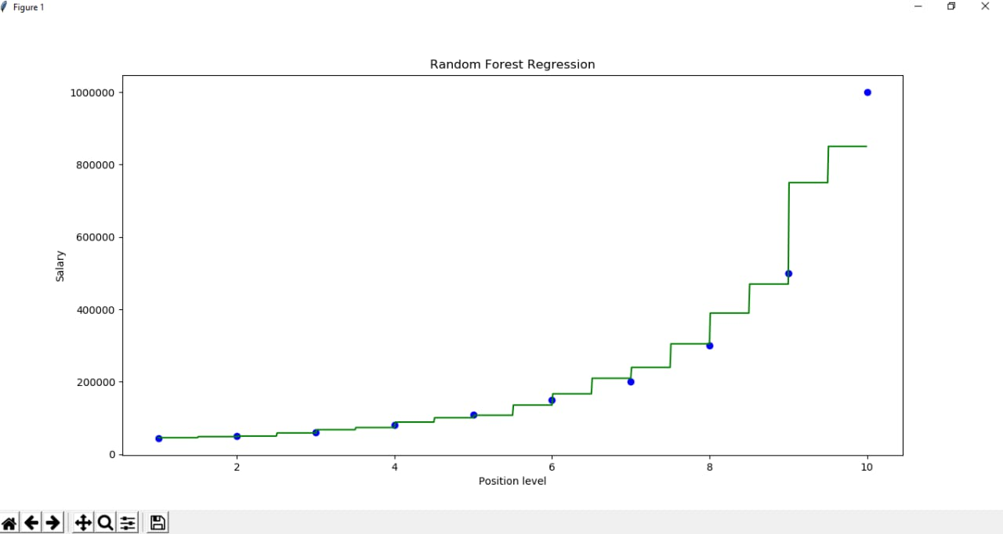

Slide 18
Execution demo:
1.We have used student grade prediction Data Set, downloaded from a website called Kaggle which has different attributes.
2. We imported all the necessary libraries in python like Pandas, NumPy, Sklearn , Matplotlib, seaborn.
3. We worked on our dataset by finding the null values and performed the cleaning.
4.Then as part of data pre-processing we performed feature correlation by which we reduced the no .of features.

Slide 19
5.After feature scaling, we divide the data into training set and testing data.
6. Now we applied particular algorithms to train the data.
7.After training we found the accuracy using confusion matrix and build the model with the high accuracy
algorithm(which we got for random forest).

Slide 20
SYSTEM REQUIREMENT SPECIFICATION
S.NO | REQUIREMENTS | REQUIREMENT NO. | ESSENTIAL/DESIRABLE | DESCRIPTION
1. | Loading of data set | RS2 | Essential | Data set should be loaded without any errors
2. | Data Cleaning | RS3 | Essential | Data Should be cleaned properly
3. | Feature Selection | RS4 | Essential | Feature Selection is performed using heat map
4. | Splitting of Data set into train and test data | RS5 | Essential | According to the given ratio the data set should be split into train and test data
5. | Random forest algorithms are called for given data set | RS6 | Essential | Each of the model applied should work without any errors
6. | Analysis | RS7 | Essential | Algorithms are compared

Slide 21
Test case:
S NO. | REQUIREMENTS | REQ. NO | ESSENTIAL/DESIRABLE | DESCRIPTION | EXPECTED OUTPUT | ACTUAL OUTPUT | RESULT
1. | Loading of data set | RS2 | Essential | Data set is downloaded from Kaggle and then loaded | Data set should be loaded without any errors | Data set should be loaded without any errors | Success
2. | Data Cleaning | RS3 | Essential | Data set is checked for null values ; if any null values are found they should be handled | Data should be cleaned and should contain no null values | No null values are found | Success
3. | Feature selection | RS4 | Essential | Feature selection is done by using heat map | Heatmap shows whether all columns are relevant or not to the target | Heatmap is generated and all the feautres are found to be significant | Success
4. | Splitting of data set into train and test data | RS5 | Essential | Data set is split into train and test data in the ratio 8:2 | According to the given ratio the data set should be split into train and test data | The given data set is split into train and test data in 8:2 ration | Success
5. | Random forest algorithms are called for given data set | RS6 | Essential | Random forest are applied | Each of the model applied should work without any errors | Results are classified into fraud and non fraud transaction | Success
6. | Evaluation and comparison of models | RS7 | Essential | The confusion matrix, accuracy, precision, recalll and FI-score are measured | All the evaluation properties are measured properly | All the properties are measured and compared | Success

Slide 22
CONCLUSION:
Early GPA predictions are a valuable source for determining students performance. We use machine learning algorithms for predicting student’s performance .we used algorithms like linear regression ,random forest and baseline .This model can be used as a component of an early warning system that will lead to students’ motivation and provides them early warnings if they need to improve their knowledge in the courses.

Slide 23
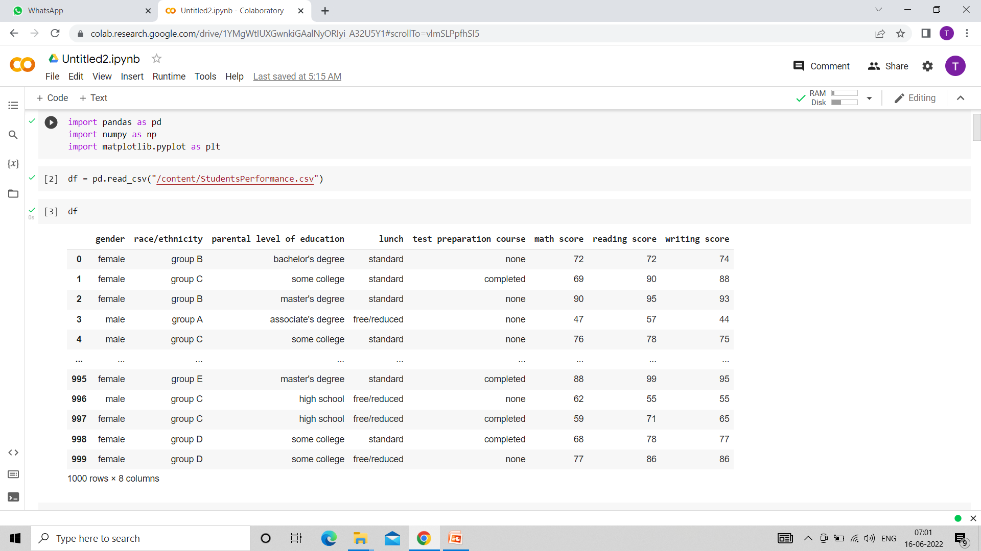
INPUT/OUTPUT:

Slide 24
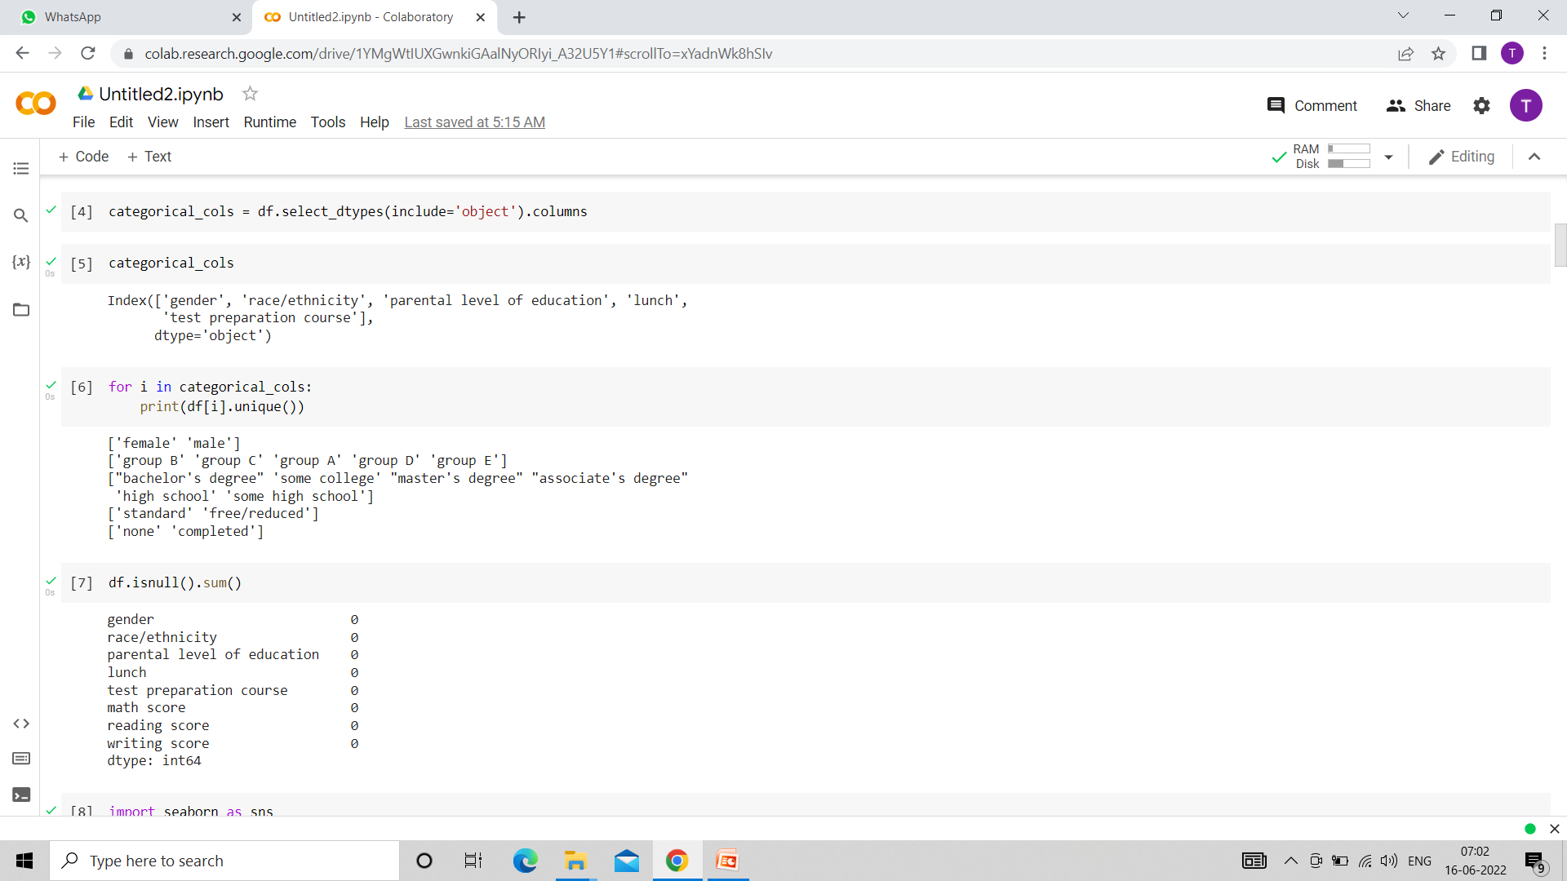

Slide 25
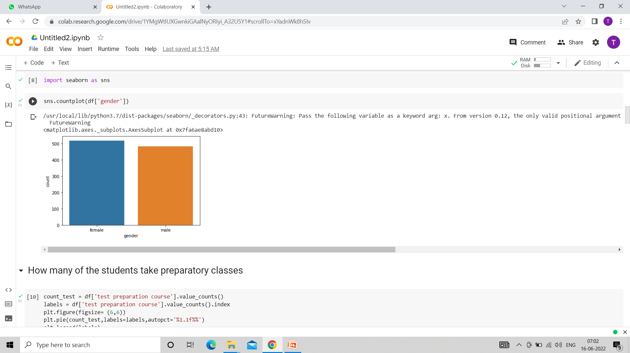
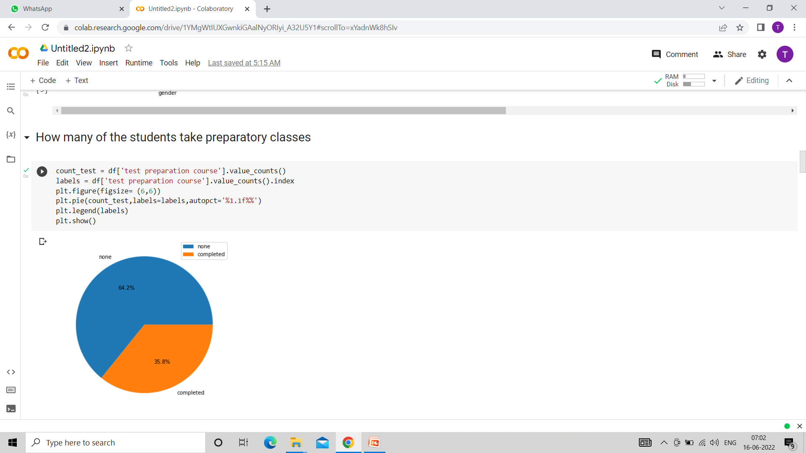

Slide 26
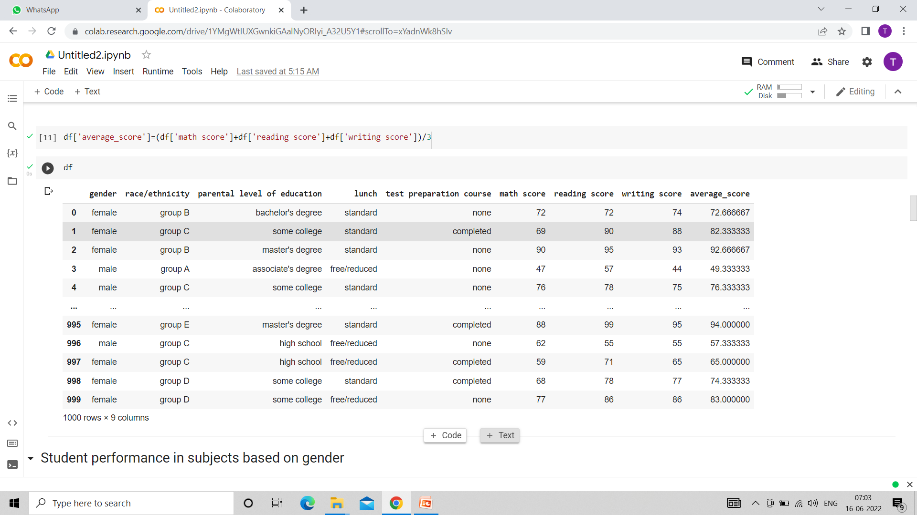

Slide 27
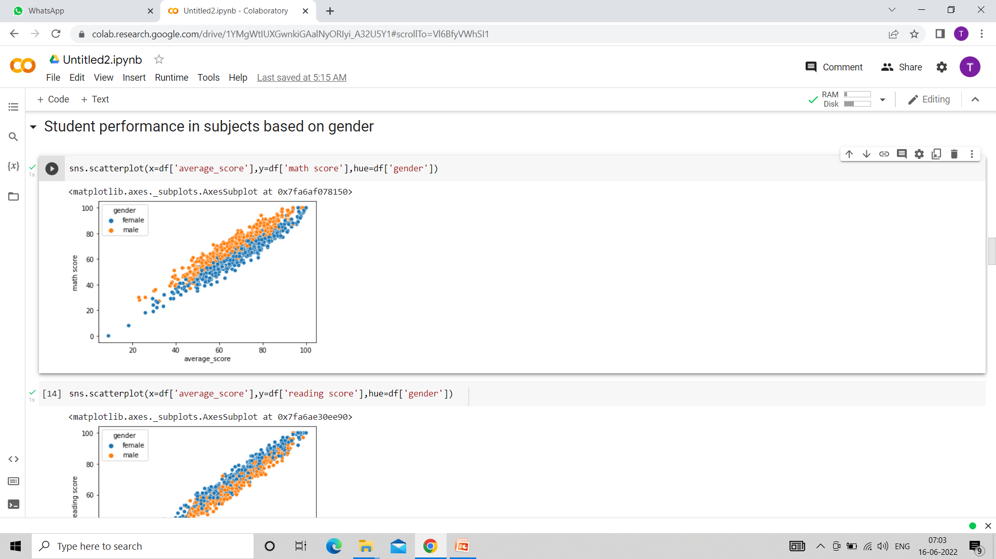

Slide 28
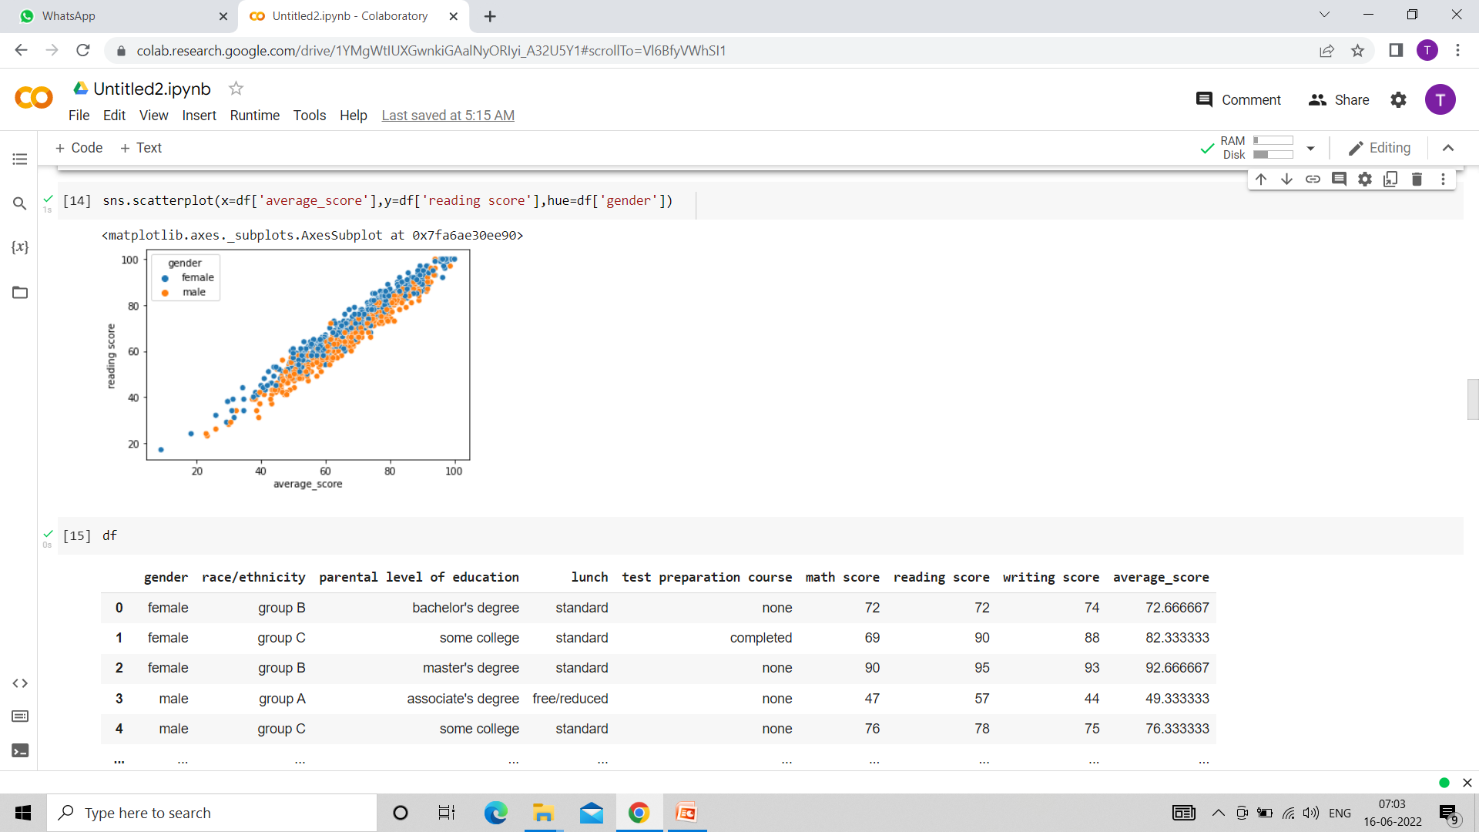

Slide 29
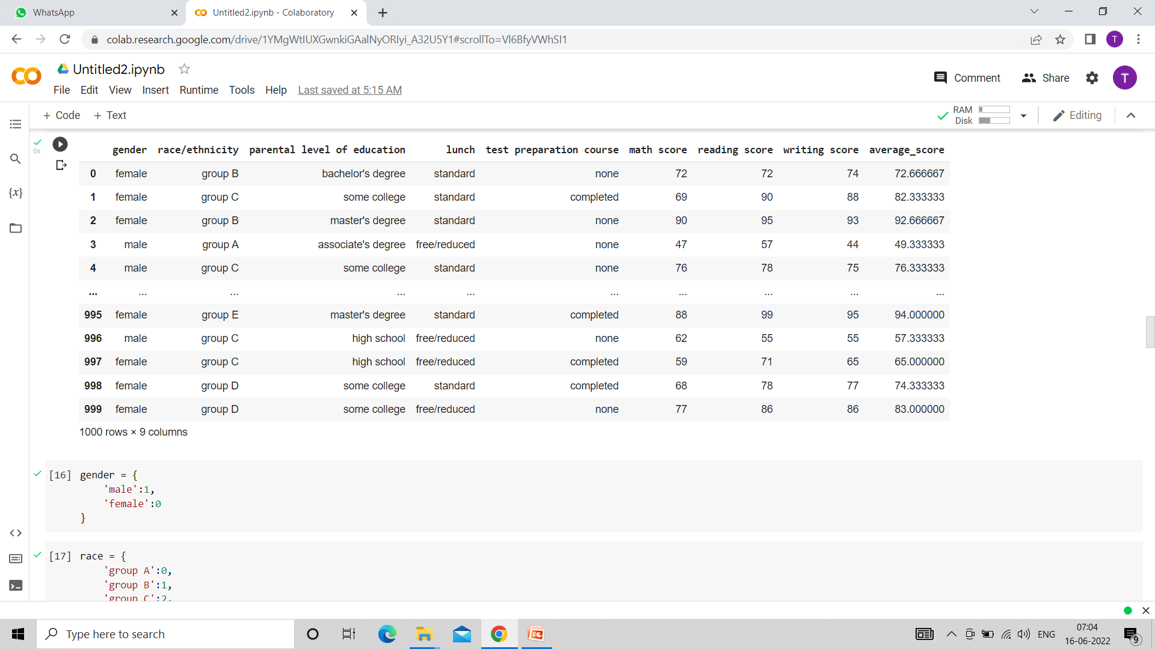

Slide 30
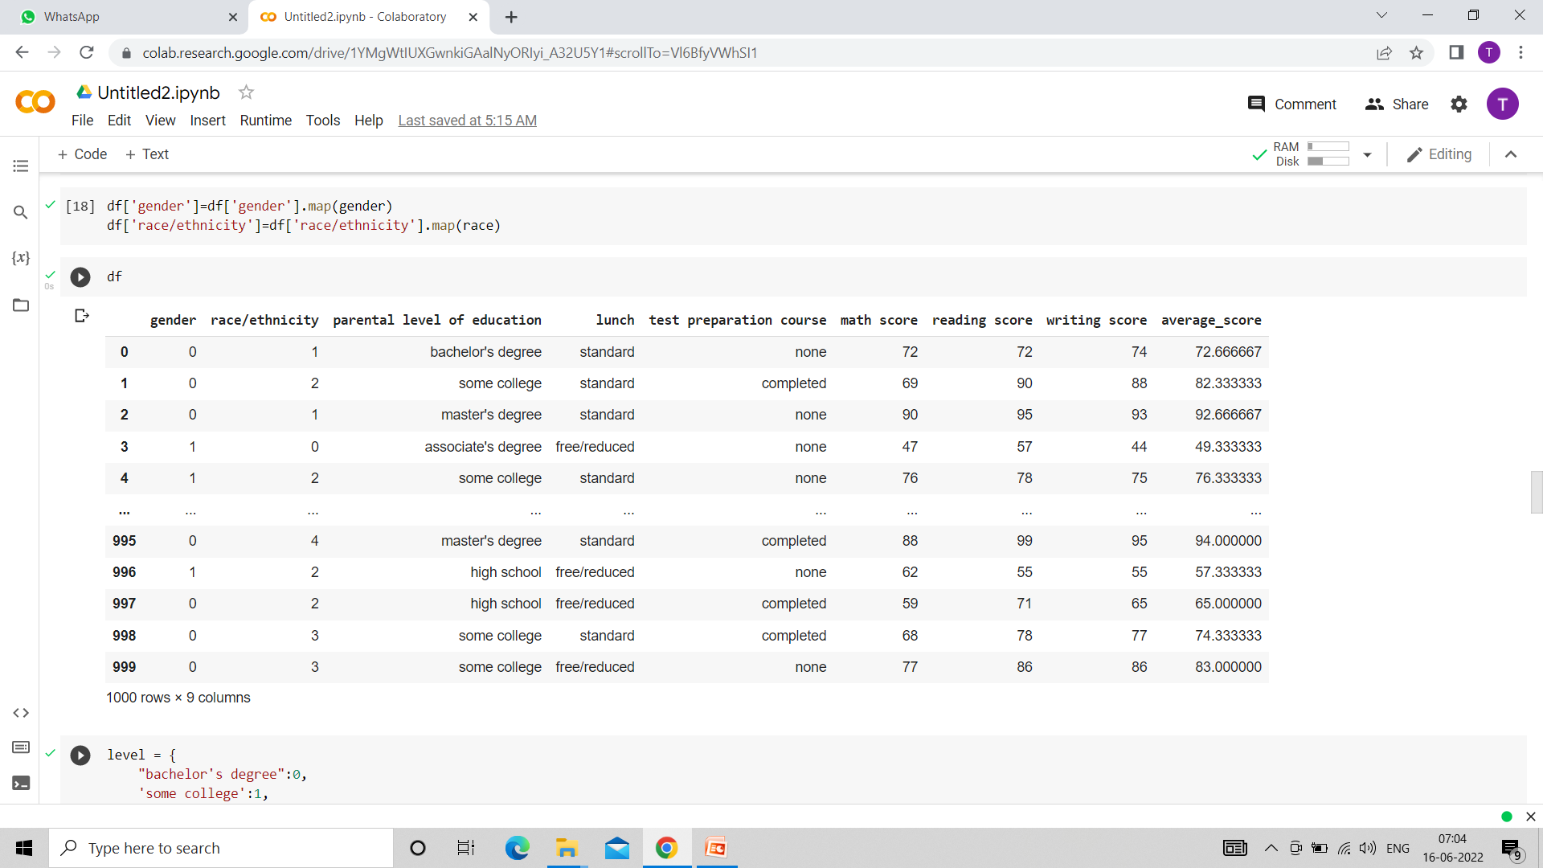

Slide 32
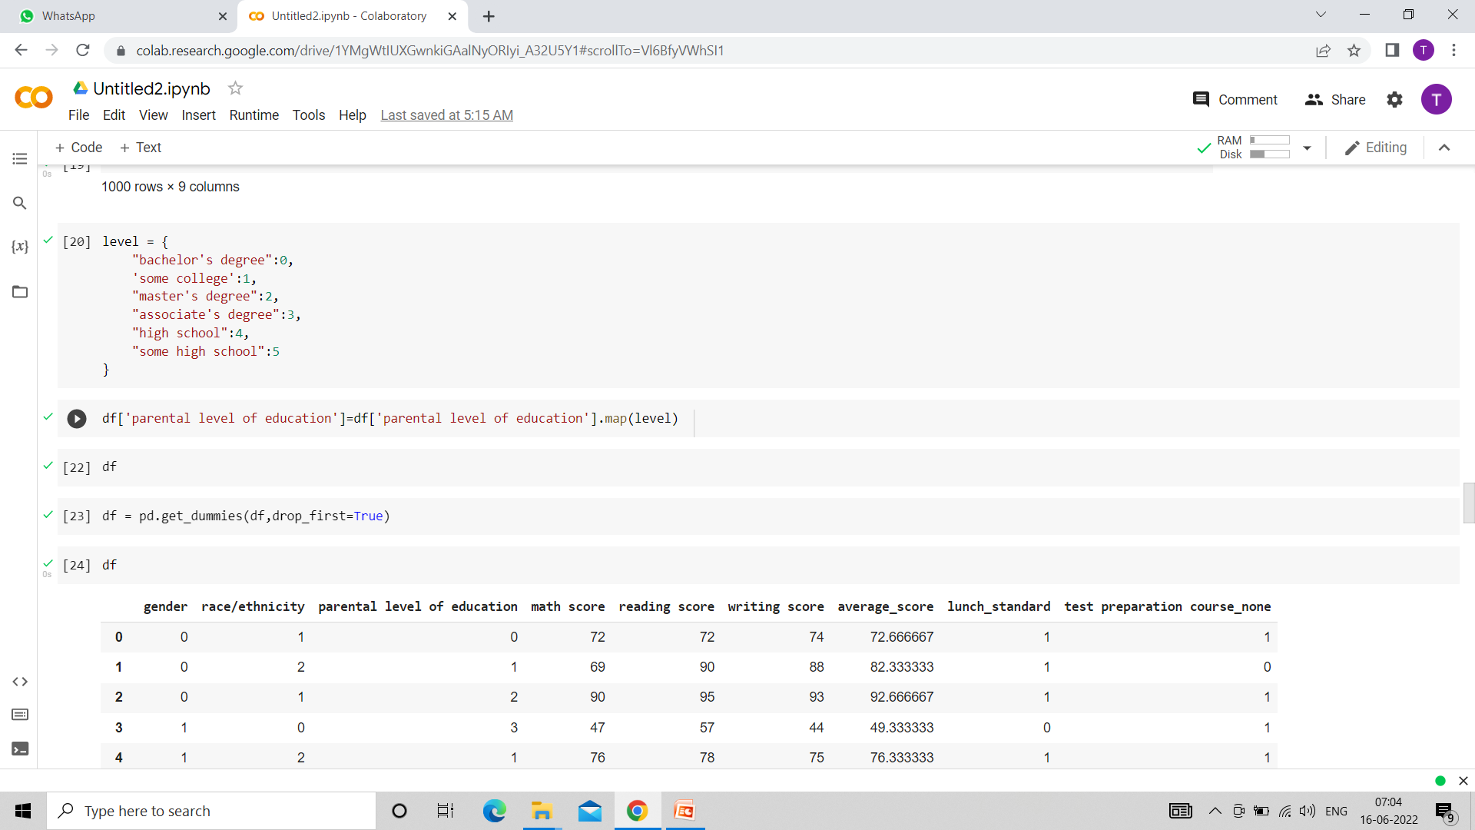

Slide 33
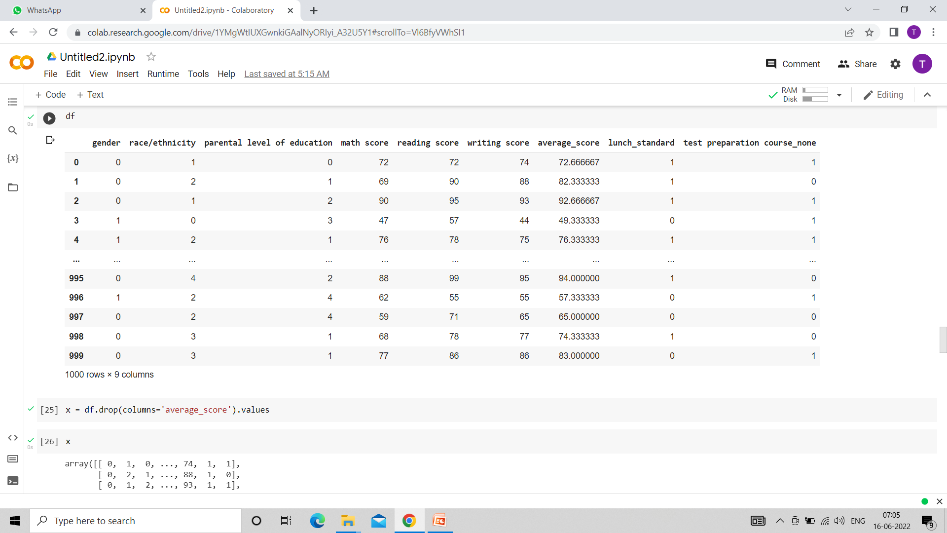

Slide 34
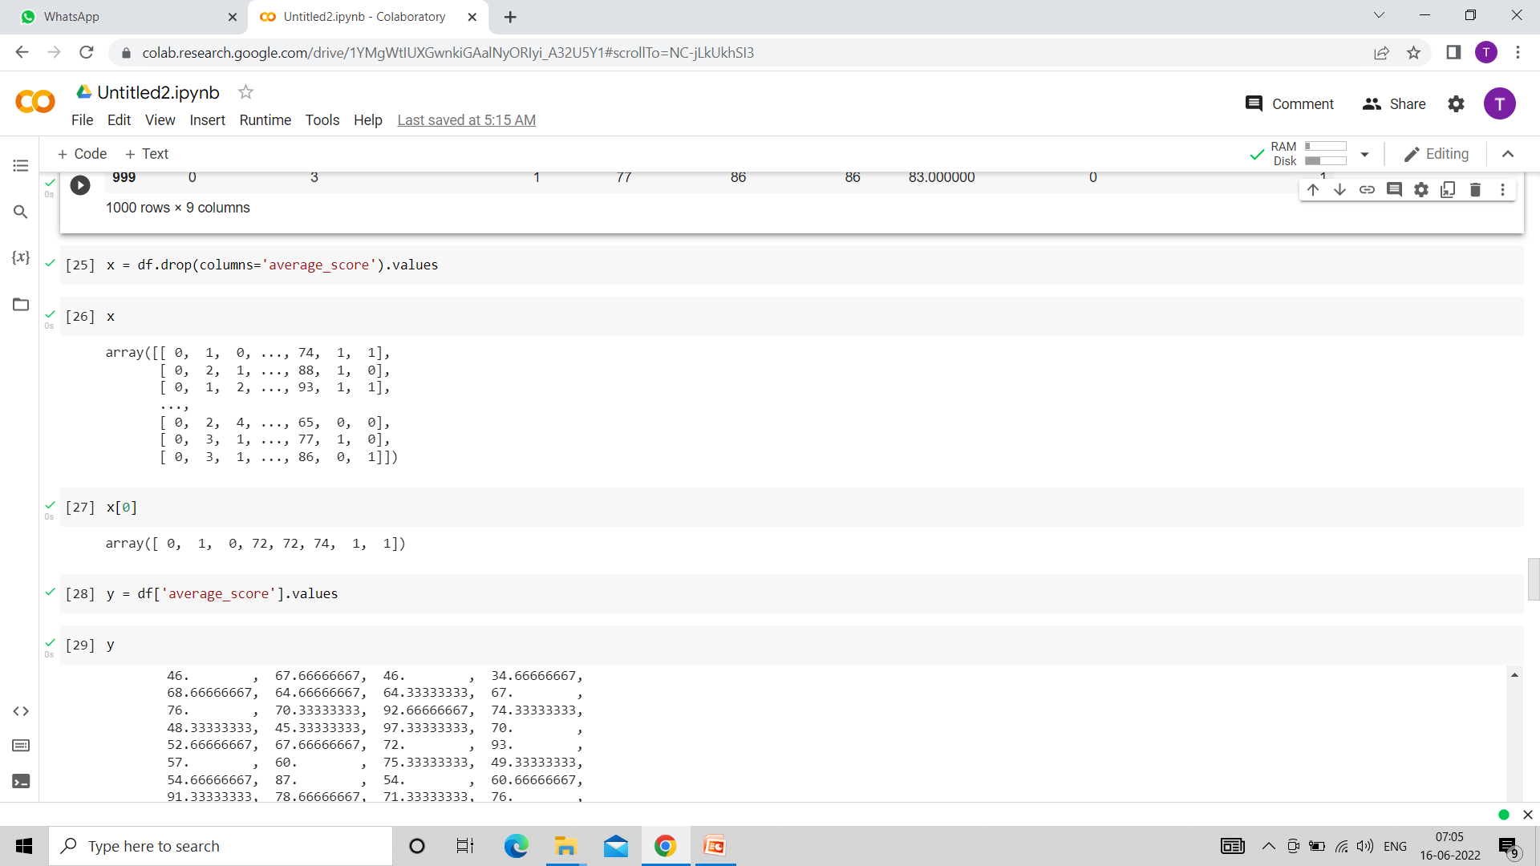

Slide 35
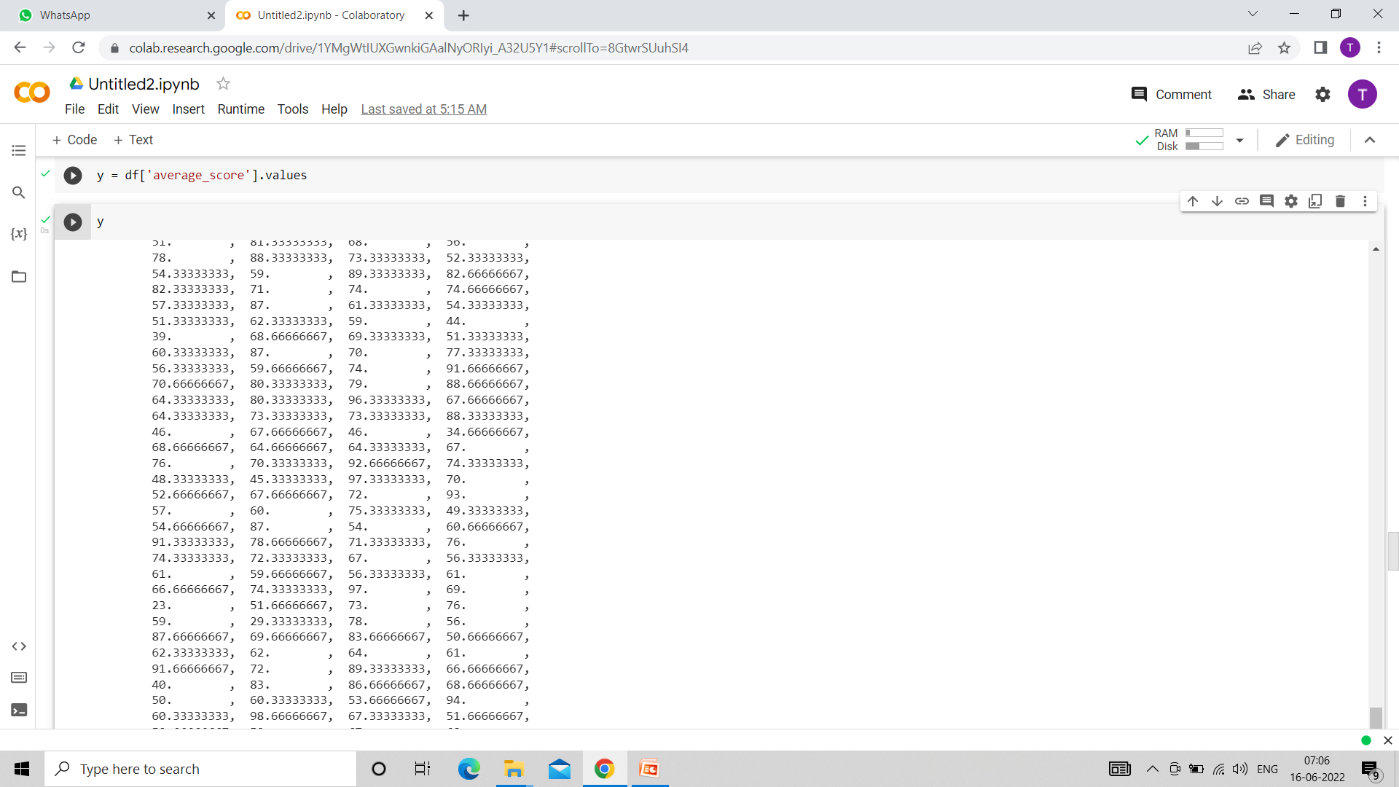

Slide 36
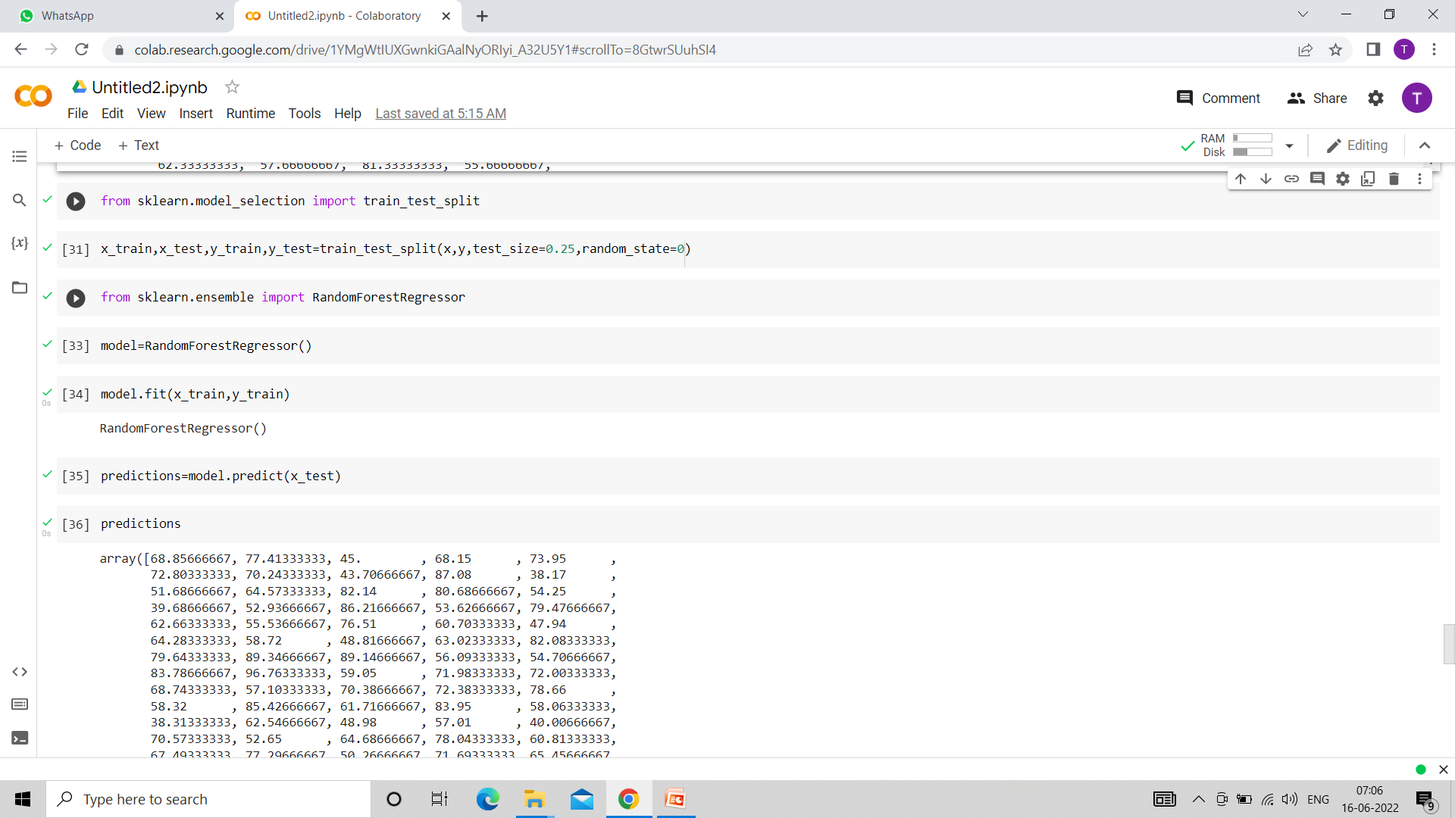

Slide 37
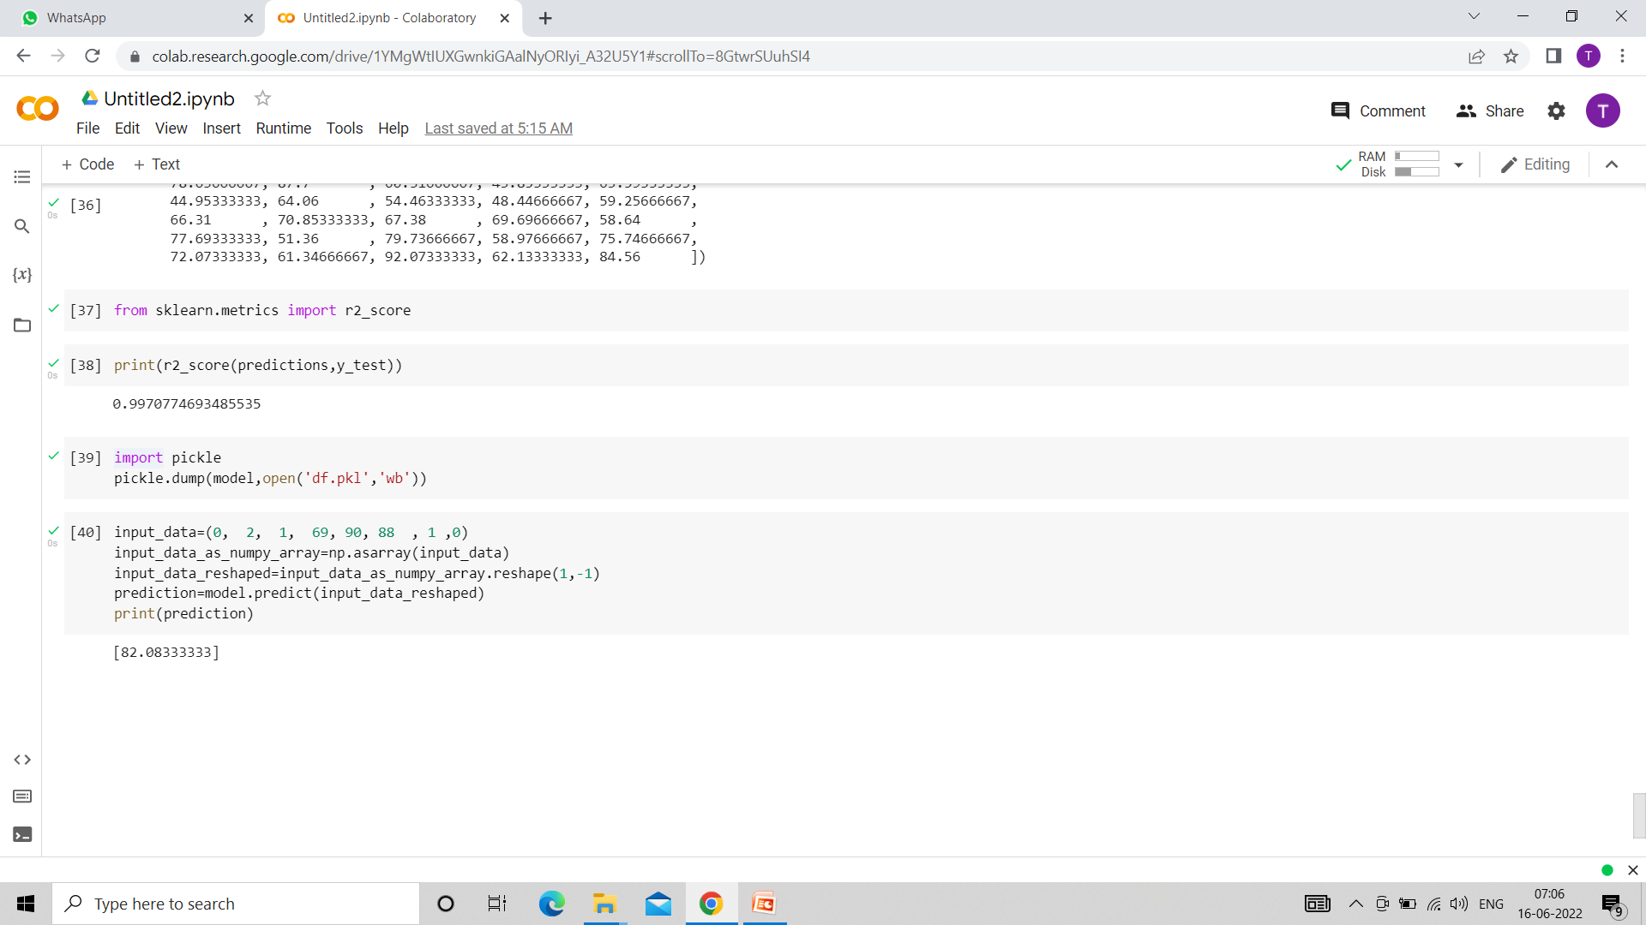

Slide 38
THANK
YOU

